Slide 1
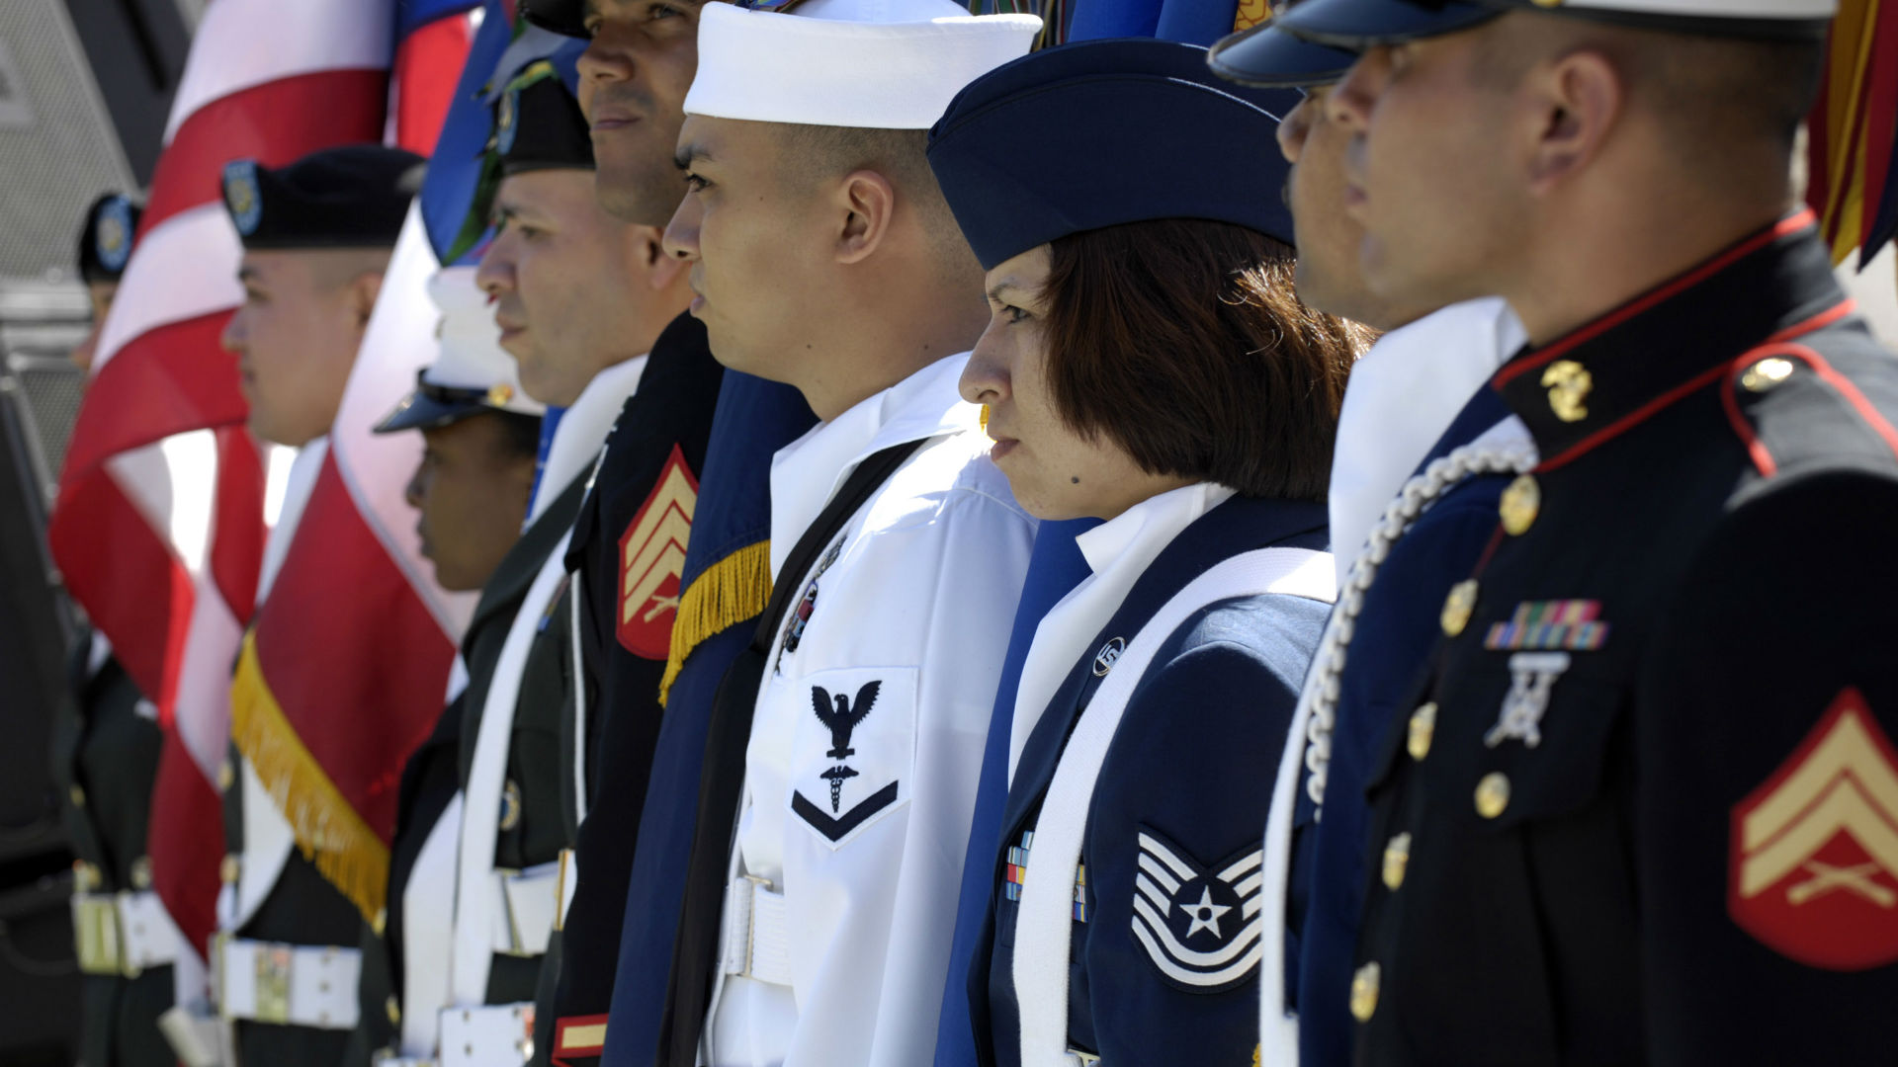

MILITARY 101
A brief overview on the training, skills, and education of military Service members, as well as resources to assess the transferability of those skills to the civilian workforce.
August 2020

Slide 2





Discussion Topics
What are the different branches of the military?
What are the ranks in the U.S. Military?
What types of experience do Service members attain?
What type of training and education do Service members receive?
What tools are available to assess transferability of military skills and training?

Slide 3
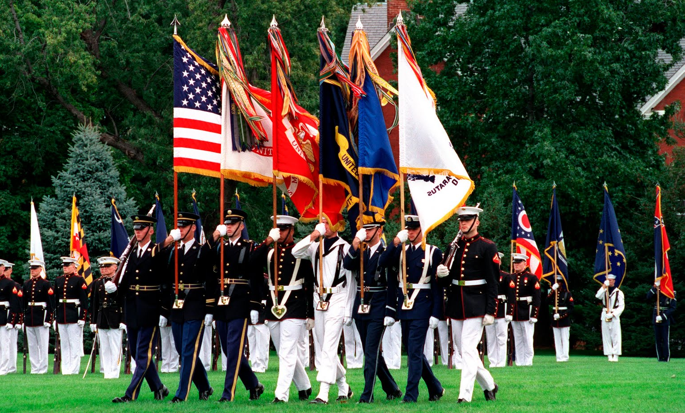
What are the different branches AND COMPONENTS of the military?

Slide 4

Army
Mission: “To deploy, fight and win our nation’s wars by providing ready, prompt and sustained land dominance by Army forces across the full spectrum of conflict as part of the joint force.”
The Army is the Nation’s oldest service, and as such, precedes all other services in matters of protocol
Notes:
Citation: https://www.army.mil/about/

Slide 5

Navy
Mission: “The Department of the Navy will recruit, train, equip, and organize to deliver combat ready Naval forces to win conflicts and wars while maintaining security and deterrence through sustained forward presence.”
Of all the services, the U.S. Naval Academy has produced the most astronauts, as well as the first American in space (Alan Shepard, Rear Admiral, USN, Ret.).
Notes:
Citation:
https://www.thebalancecareers.com/so-you-want-to-become-an-astronaut-3345123#:~:text=Fun%20FACT%3A%20The%20United%20States,astronauts%20than%20any%20other%20institution.
https://er.jsc.nasa.gov/seh/shepard.htmhttps://er.jsc.nasa.gov/seh/shepard.htm

Slide 6

Air Force
The mission of the U. S. Air Force is to fly, fight and win ... in air, space, and cyberspace.
The Air Force was established with the National Security Act of 1947, along with the Central Intelligence Agency, and the National Security Council.
Notes:
Citation:
https://www.af.mil/About-Us/Fact-Sheets/Display/Article/104613/the-us-air-force/
https://history.state.gov/milestones/1945-1952/national-security-act#:~:text=The%20National%20Security%20Act%20of,National%20Security%20Council%20(NSC).

Slide 7

Space Force
The US Space Force “is a military service that organizes, trains, and equips space forces in order to protect U.S. and allied interests in space and to provide space capabilities to the joint force. ”
The Space force motto Semper Supra means “Always Above.”
Notes:
Citation:
https://www.spaceforce.mil/About-Us/About-Space-Force

Slide 8

Marine Corps
“As America's expeditionary force in readiness since 1775, the U.S. Marines are forward deployed to win our Nation’s battles swiftly and aggressively in times of crisis. We fight on land, sea and air, as well as provide forces and detachments to naval ships and ground operations.”
Famous Marines include Adam Driver, Gene Hackman, James Carville, and Bob Keeshan (a.k.a Captain Kangaroo)
Notes:
Citation
https://www.marines.com/who-we-are/our-purpose.html#:~:text=Our%20Mission,naval%20ships%20and%20ground%20operations.
https://www.businessinsider.com/20-people-you-didnt-know-were-united-states-marines-2012-7

Slide 9

US Coast Guard
The Coast Guard is the principal Federal agency responsible for maritime safety, security, and environmental stewardship in U.S. ports and waterways.
As one of the five Armed Services of the United States, the Coast Guard is the only military branch within the Department of Homeland Security.
Notes:
Citation: Homeland Security Digital Library, United States Coast Guard: Overview, https://www.hsdl.org/?view&did=819993

Slide 10

Components
Each service branch offers full- and part-time service commitments to their members, dividing their forces into three subsets:
ACTIVE DUTY
RESERVES
NATIONAL GUARD
All Services
Full time
All Services
Part time
Army & Air Force
Part time

Slide 11
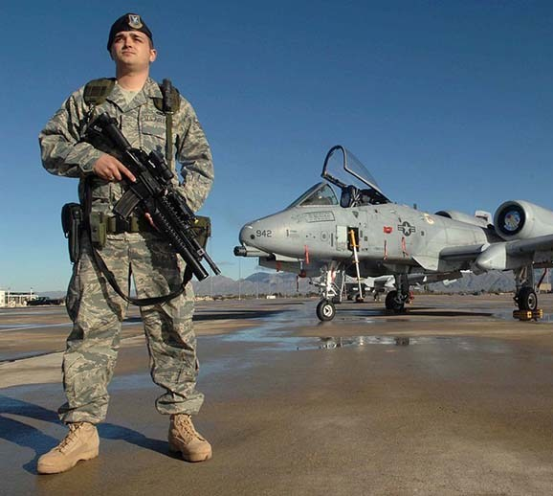
Components – Active Duty
Branches: Army, Navy, Air Force, Marine Corps, Space Force, and Coast Guard
A person who is "active duty" is in the military full time, may live on a military base, and can be deployed at any time. To assist in their career development—as well as meet national security needs—most military personnel move frequently from one geographic duty location to another. On average, officers move every two to three years and enlisted personnel move every four years.

Slide 12
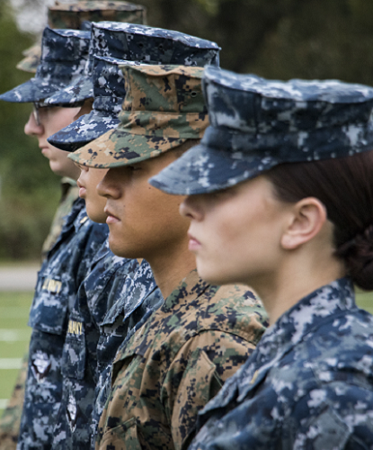
Components - Reserve
Branches: Army, Navy, Air Force, Marine Corps, and Coast Guard
Each branch of the military has a Reserve component, which is under the command of their respective military branch (e.g., Army Reserve is under the command of the Army). The purpose of the Reserve is to provide and maintain trained, qualified units available for active duty when needed. This may be in times of war overseas, in a national emergency, or as the need occurs based on threats to national security.
Historically, the primary job of the Reserve has been to fill gaps in stateside service positions when active duty forces ship overseas. In recent conflicts, Reserve units have deployed directly to overseas locations. At a minimum, members of the Reserve are required to participate in training drills (AKA "Drill") one weekend each month and two consecutive weeks per year.

Slide 13
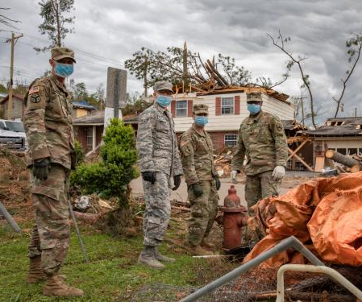
Components – National Guard
Branches: Army and Air Force
The National Guard consists of the Army National Guard and the Air Force's Air National Guard. Though federally funded, it is organized and controlled by the states under the authority of each state’s governor. In times of war or national crisis, the National Guard can become federalized and deployed by federal command authorities. During local emergencies, these units assist communities endangered by storms, floods, fires, and other disasters.
Specialized units deployed overseas are prepared for and may see combat action, but traditionally Guard units are directed to work more in humanitarian relief or peacekeeping roles such as building schools and hospitals or training local peacekeepers. As with the Reserve, the National Guard requires training drills one weekend a month and two weeks per year at a minimum.

Slide 14
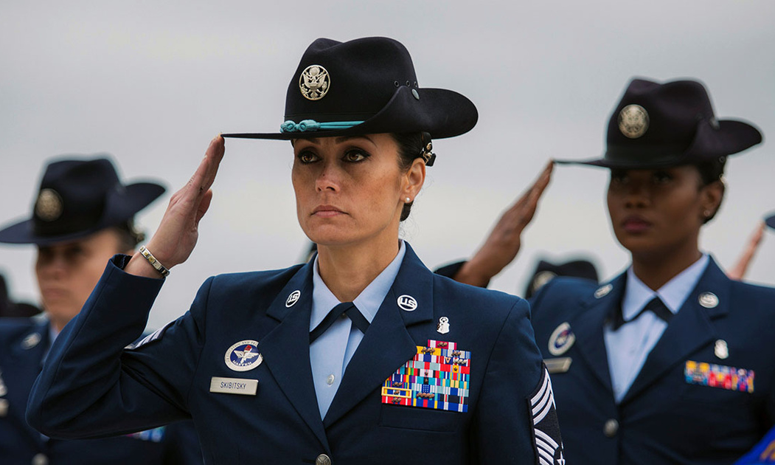
What are the ranks in the u.s. Military?

Slide 15
Enlisted Rank Structure
Pay Grade | MARINES | ARMY | AIR FORCE | NAVY/CG
E-1 | Private | Private | Airman Basic | Seaman Recruit
E-2 | Private First Class | Private | Airman | Seaman Apprentice
E-3 | Lance Corporal | Private First Class | Airman First Class | Seaman
E-4 | Corporal | Army Specialist/Corporal | Senior Airman | Petty Officer Third Class
E-5 | Sergeant | Sergeant | Staff Sergeant | Petty Officer Second Class
E-6 | Staff Sergeant | Staff Sergeant | Technical Sergeant | Petty Officer First Class
E-7 | Gunnery Sergeant | Sergeant First Class | Master Sergeant | Chief Petty Officer
E-8 | Master Sergeant First Sergeant | Master Sergeant First Sergeant | Senior Master Sergeant | Senior Chief Petty Officer
E-9 | Master Gunnery Sergeant Sergeant Major Sergeant Major of the Marine Corps | Sergeant Major Command Sergeant Major Sergeant Major of the Army | Chief Master Sergeant Command Chief Master Sergeant Chief Master Sergeant of the Air Force | Master Chief Petty Officer Command Master Chief Petty Officer Force Master Chief Petty Officer Fleet Master Chief Petty Officer Master Chief Petty Officer of the Navy
Senior Enlisted Advisor | Sergeant Major of the Marine Corps | Sergeant Major of the Army | Chief Master Sergeant of the Air Force | Master Chief Petty Officer of the Navy/Coast Guard

Slide 16
Warrant Officer Rank Structure
Pay Grade | ARMY | MARINES | NAVY/CG
W-1 | W01 Warrant Officer 1 | WO Warrant Officer 1
W-2 | CW2 Chief Warrant Officer 2 | CWO2 Chief Warrant Officer 2 | CW02 Chief Warrant Officer 2
W-3 | CW3 Chief Warrant Officer 3 | CWO3 Chief Warrant Officer 3 | CW03 Chief Warrant Officer 3
W-4 | CW4 Chief Warrant Officer 4 | CWO4 Chief Warrant Officer 4 | CW04 Chief Warrant Officer 4
W-5 | CW5 Chief Warrant Officer 5 | CWO5 Chief Warrant Officer 5 | CW05 Chief Warrant Officer 5

Slide 17
Officer Rank Structure
Pay Grade | ARMY |  | MARINES |  | AIR FORCE |  | NAVY/CG
Company Grade
0-01/01E | Second Lieutenant | Second Lieutenant | Second Lieutenant | Second Lieutenant | Second Lieutenant | Ensign | Ensign
0-02/02E | First Lieutenant | First Lieutenant | First Lieutenant | First Lieutenant | First Lieutenant | Lieutenant (Jr Grade) | Lieutenant (Jr Grade)
0-03/03E | Captain | Captain | Captain | Captain | Captain | Lieutenant | Lieutenant
Field Grade
0-04 | Major | Major | Major | Major | Major | Lieutenant Commander | Lieutenant Commander
0-05 | Lieutenant Colonel | Lieutenant Colonel | Lieutenant Colonel | Lieutenant Colonel | Lieutenant Colonel | Commander | Commander
0-06 | Colonel | Colonel | Colonel | Colonel | Colonel | Captain | Captain
General/Flag Officer
0-7 One Star | Brigadier General | Brigadier General | Brigadier General | Brigadier General | Brigadier General | Rear Admiral (Lower Half) | Rear Admiral (Lower Half)
0-8 Two Star | Major General | Major General | Major General | Major General | Major General | Rear Admiral (Upper Half) | Rear Admiral (Upper Half)
0-9 Three Star | Lieutenant General | Lieutenant General | Lieutenant General | Lieutenant General | Lieutenant General | Vice Admiral | Vice Admiral
0-10 Four Star | General | General | General | General | General | Admiral | Admiral

Slide 18
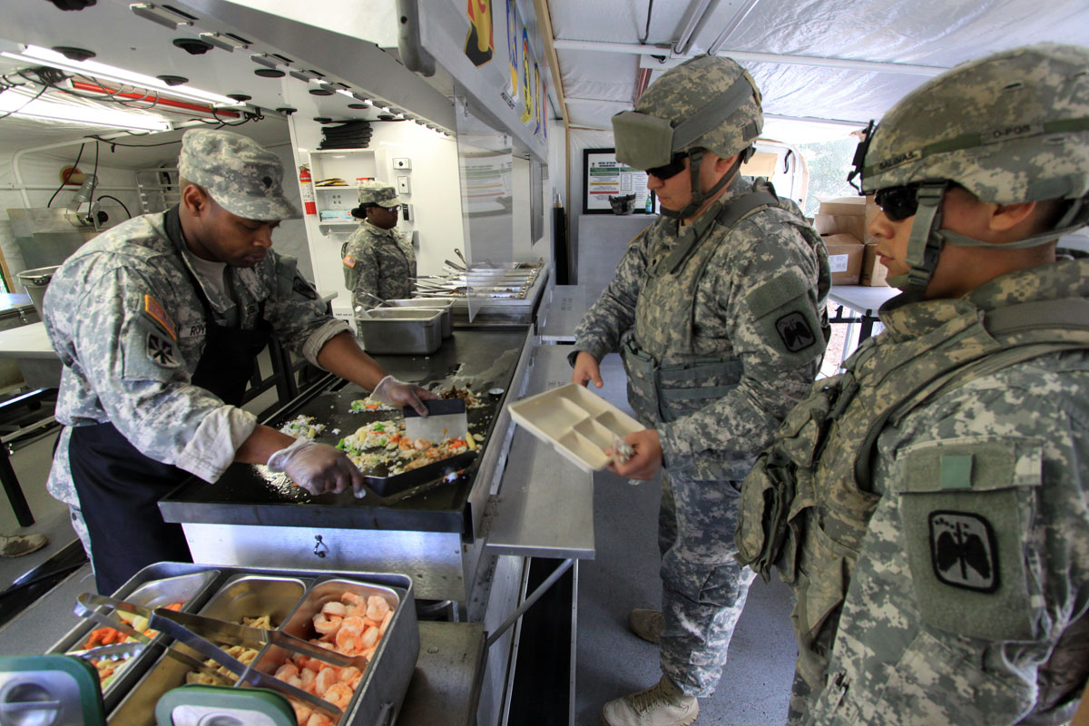
What types of experience do service members ATTAIN?

Slide 19
Personnel Categories
Within all branches of the military, Service members fall into three major personnel categories:
Enlisted personnel - the first-line labor force
Warrant Officers - specialized technical consultants
Commissioned Officers - comprise management and leadership teams
The primary differences among personnel in these categories is their education level upon entry to the service and the types of job duties they perform. Within each of the groups, service members are assigned both a military rank and a pay grade, both of which can shed light on where they are in terms of career progression.
Notes:
2018 Profile of the Military Community
Total Force (Active Duty, Civilian, Ready Reserve):
Enlisted = 1,739,012 | 82.8%
Officers = 362,122 | 17.2%
Active Duty (Army, Navy, Marine Corps, Air Force):
Enlisted = 1,073,394 | 82.3%
Warrant Officer = 18,154 | 1.4%
Officer = 212,870 | 16.3%
Ready Reserve
Enlisted = 670,715 | 83.5%
Warrant Officer = 12,660 | 1.6%
Officer = 119,467 | 14.9%
Active Duty and Ready Reserve
Enlisted = 1,744,109 | 82.8%
Warrant Officer = 30,814 | 1.5%
Officer = 332,337 | 15.8%

Slide 20
Military Career Options
 | Enlisted | Warrant Officer | Officer
Primary Duties | Carry out fundamental operations of the military | Highly specialized experts in their field and trainers | Managers, leaders, problem solvers, planners
Percentage of Armed Forces | 84% | 1% | 15%
Education Level Upon Entry | High School Degree or Equivalent | High School Diploma or Equivalent; College Degree | College Degree
Pay Grades | E-1 to E-9 | WO-1 TO WO-5 | O-1 to O-10
Assessing Transferability of Skills | Can be difficult due to unique military job titles, but skills are highly transferrable | Not too difficult due to job title similarities and degrees held

Slide 21

Learning the Lingo: Military Occupations
Looking for a Construction Laborer?
Army – 51B – Carpentry and Masonry Specialist
Navy – BU – Builder
Air Force – 3E351 – Structural Journeyman
Marines – 1371 – Operating Engineer
Coast Guard – DC – Damage Controlman
Service | Enlisted | Warrant Officers | Officers
Army | Military Occupational Specialty (MOS) | Warrant Officer MOS (WO MOS) | Area of Concentration (AOC)
Navy/ CG | Rating | Chief Warrant Officer (CWO) | Designator, LDO, CG Specialty
Air Force | Air Force Specialty Code (AFSC) | N/A | AFSC
Marine Corps | Military Occupational Specialty (MOS) | MOS (WO MOS) | MOS

Slide 22
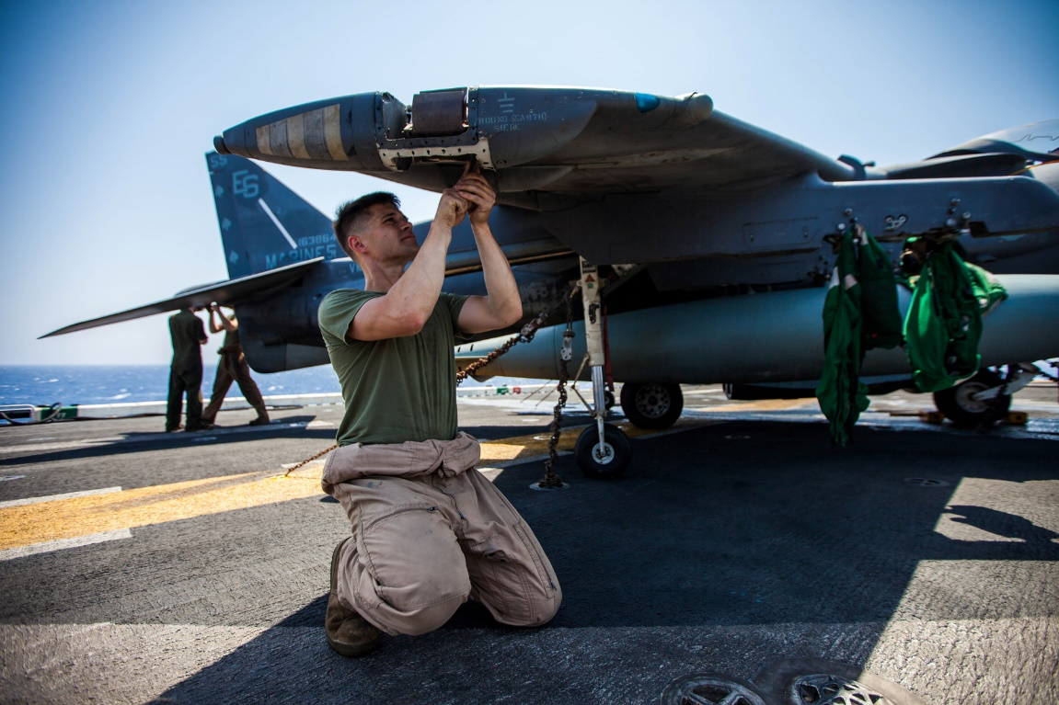
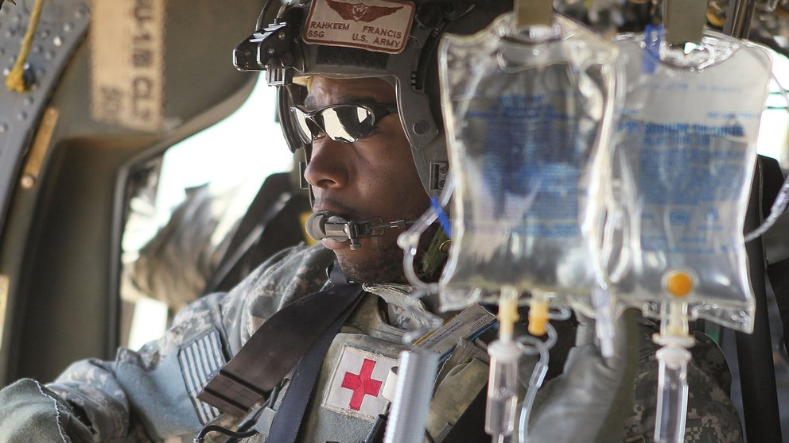
Top 10 Occupational Areas of Transitioning Military Personnel
Aircraft Mechanics
Automotive Service Technicians and Mechanics
Computer Support Specialist/Operators/ Security Specialists
Cooks/Food Preparation Workers
Health Care Support Occupations
Police/Security Guard
Supply Chain (Shipping, Receiving/Traffic Clerks OR Stock Clerks/Order Filers/Logisticians)
Truck Driver
Military Specific

Slide 23
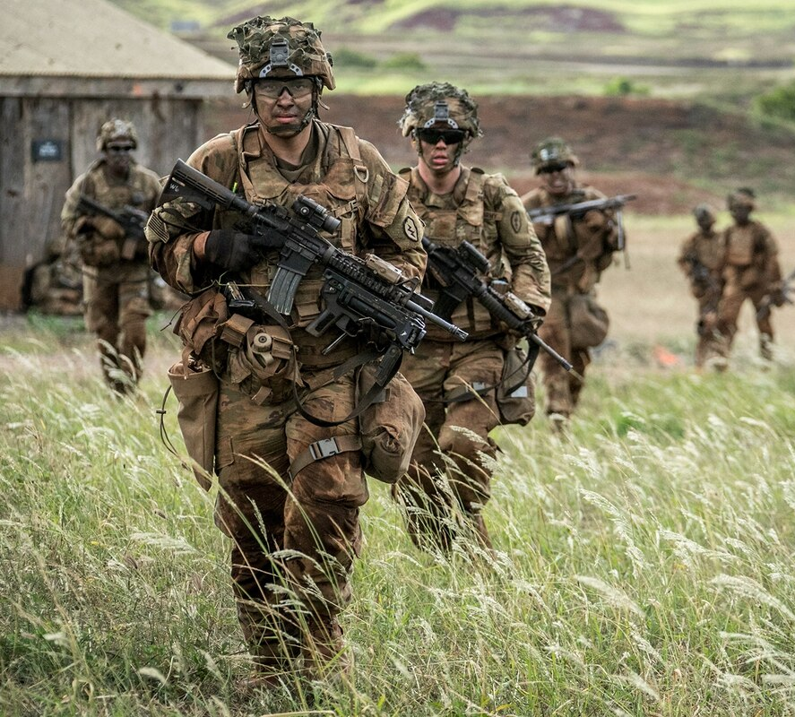
Military Occupations with No Civilian Job Equivalents
Vast majority of military occupations have a direct civilian job equivalent
Army and Marine Corps have largest numbers of enlisted Service members with no direct civilian job equivalent (e.g., Infantry, Mortar Man, Field Artillery)
Lack of direct civilian occupational equivalent:
Does not mean that the Service member lacks transferrable skills
Does make it more difficult for Service members to document the transferability of their skills

Slide 24


Civilian Credentialing Opportunities
For transitioning service members, certifications and licenses are a means of demonstrating to civilian employers that their skills are on par with those of their civilian counterparts.
Service members have a high success rate in attaining civilian credentials. High pass rates demonstrate the relevance of military training and experience to civilian jobs.
CERTIFICATION AND LICENSURE EXAM PASS RATES
85%
+
70%
One statistic from the Navy showed that its Service members have a pass rate of over 85 percent on certification and licensure exams, compared to industry average of 70 percent.

Slide 25











Collateral Duties
In addition to primary duties, Service members often have collateral duties that may correspond to civilian jobs or credentials.
Command Fitness Leader
Drug and Alcohol
Counselor
Information Assurance
Command Finance
Specialist
Equal Opportunity Advisor
Senior Enlisted Leader
Correctional Custody
Specialist
Field Recruiter
Instructor

Slide 26

WHAT TYPES OF TRAINING AND EDUCATION DO SERVICE MEMBERS RECEIVE?

Slide 27


Military Training vs. Education
Training
Education
Compensatory
Mission-related
Formal and informal
Voluntary
May or may not be military occupation-specific
VS
Career Roadmaps help guide Service members to training and education opportunities

Slide 28
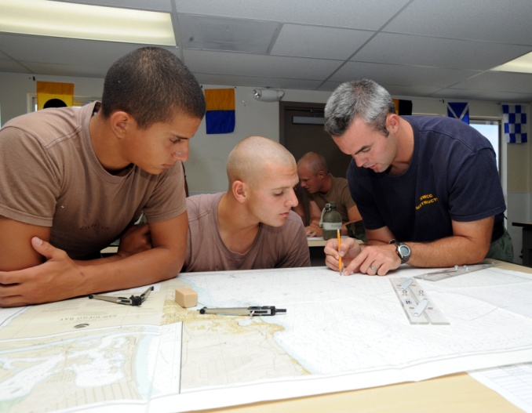



Military Training
Boot Camp
Initial Technical Training
Continued Training Throughout Career
7 to 12 weeks
builds physical and mental stamina, develops team building skills, and orient recruits to the military mission, culture, and ethos
8 weeks to one year
intensive occupational training after basic training
e.g., A-School or Advanced Individualized Training (AIT)
Upon completion, qualified to hold their military occupational
More advanced job training
Leadership training
Specialized Skills Training
More than 60% of formal training qualifies as college credit

Slide 29
Training during the Military Life Cycle
Advanced Skills
(soft/technical/
Managerial)
Intermediate Skills
(soft/technical/
managerial)
Basic Skills
(soft/technical)
Early Career
(E-1 to E-4)
Early Career
(E-6 to E-7)
Late Career
(E-8 to E-9)

Slide 30




Voluntary Education
Provides variety of off-duty continuing education options
Postsecondary Degree Programs
Tuition Assistance
Military Evaluations Program
Credentialing
Opportunities
Each year about 300,000 Service members sign up for postsecondary courses leading to college degrees (approximately 1/3 of Service members).

Slide 31


Tuition Assistance
schools must be accredited by U.S. Department of Education recognized agencies and be signatories to the current Department of Defense Memorandum of Understanding (DOD MOU)
available for in classroom or distance learning courses part of an approved academic degree or certificate program
financial assistance for voluntary off-duty education programs

Slide 32
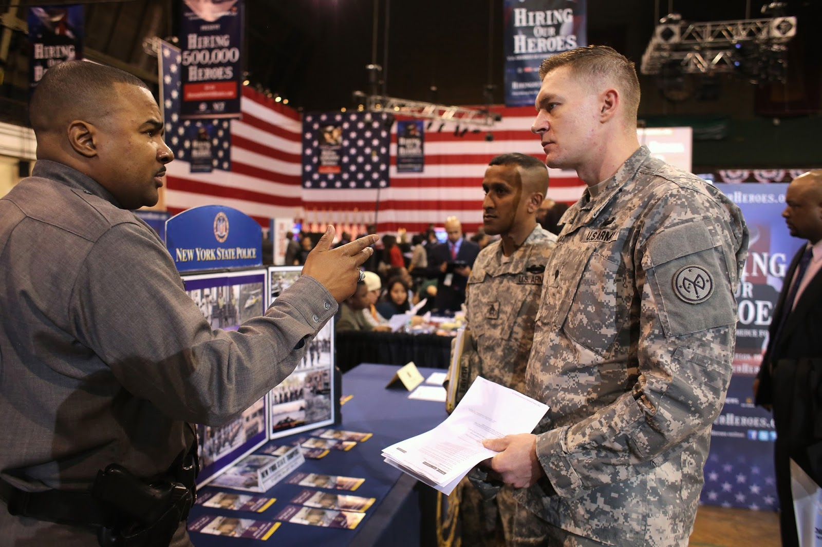
What tools are available to employers to assess transferability of military SKILLS AND training?

Slide 33






Tools to Assess Transferability of Military Skills
The COOL (Credentialing Opportunities On-Line) Programs – map credentials to military occupations and federal civilian occupations.
Access the COOL websites from the DoD COOL Portal
Notes:
COOL Tools:
Army COOL – Department of Navy COOL– https://www.cool.navy.mil
Navy COOL – https://www.cool.navy.mil/usn
Marine Corps COOL – https://www.cool.navy.mil/usmc
Air Force COOL - https://afvec.us.af.mil/afvec/Public/COOL/
Coast Guard COOL - https://www.cool.osd.mil/uscg/index.htm
DoD COOL – https://www.cool.osd.mil/
DON Civilian COOL - https://www.cool.osd.mil/dciv/index.htm
SkillBridge - https://dodskillbridge.usalearning.gov/

Slide 34
Tools to Assess Transferability of Military Skills
Additional tools
CAREERS IN THE MILITARY
MY NEXT MOVE FOR VETERANS
www.careersinthemilitary.com
A companion site to www.asvabprogram.com, houses public access to in-depth military career information
www.mynextmove.org/vets
Includes interactive tools and data for 900+ careers, including information on civilian careers with similar job skills to military occupations
DoD SKILLBRIDGE
OCCUPATIONAL OUTLOOK HANDBOOK
https://dodskillbridge.usalearning.gov
The SkillBridge program allows Service members to get civilian work experience through industry training, apprenticeships, and internships during last 180 days of service
Job Opportunities for Armed Forces
Includes details for military occupations, including duties, job outlook, pay, similar occupations, and work environment
Notes:
Department of Labor:
My Next Move for Veterans - https://www.mynextmove.org/vets/
Occupational Outlook Handbook – Job Opportunities in Armed Forces
Careers in the Military - https://www.careersinthemilitary.com/

